Slide 1

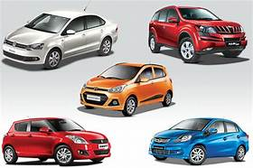
Car price prediction
DUMPALA ADITYA

Slide 2
Problem statement:-
Collect/scrape the data of used cars from various sites and built a model for predicting the price of the car based on collected data
Data source:-
Cars24,com, olx.com, Cardheko.com

Slide 3
Table of contents:-
Data Cleaning Exploratory Data Analysis Data Pre-processing Model Building Model Evaluation Selecting the best model

Slide 4
1.Data cleaning
Checking null values
Checking data types and extract new features from existing features
Converting data types based on data for better understanding of ml model
Removing unnecessary special characters from the data
Checking outliers and remove them
Adjusting the skewness value less than 0.5 for continuous features
Encoding the data by using get_dummies
Scaling the data by using minmax scaler
Using PCA for decreasing dimensions of the data set

Slide 5
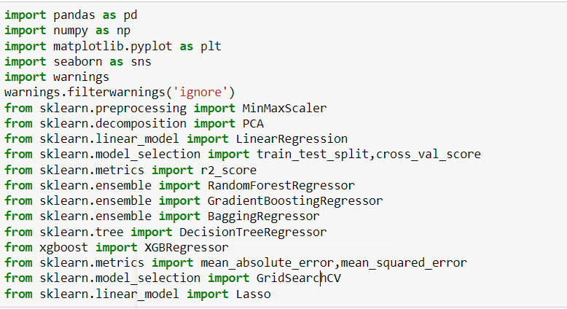
Libraries and packages iam used in this model building

Slide 6
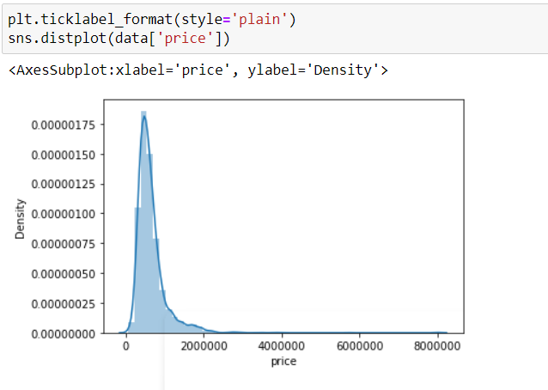
2.Exploratory Data Analysis
price
Observation:-
Price is skewed right side due to high range of the price value.

Slide 7
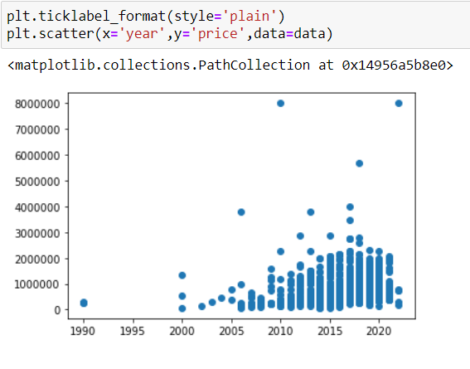
Year vs price
Observation:-
Comparing two features price and year we can observe that recent year vehicle has high price comparing with old vehicle

Slide 8
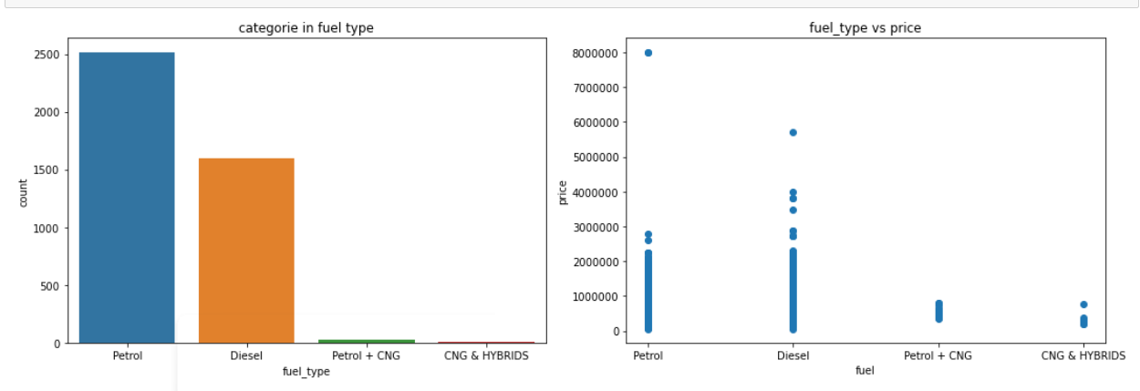
Fuel_type:-
Observation:-
Vehicles with fuel type petrol are high count but vehicles with fuel_type diesel are having high price compared to petrol we can see

Slide 9
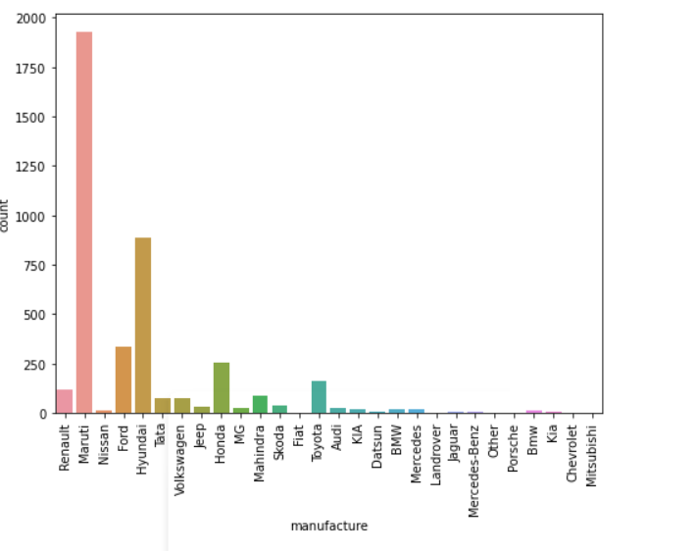
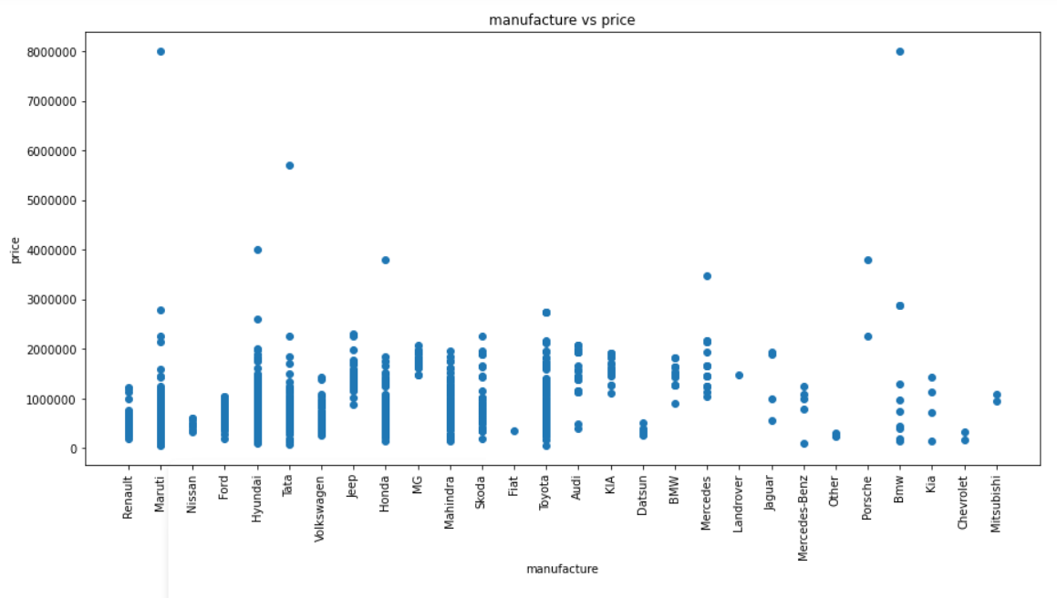
Observation:-
There are many companies are manufacturing vahicles but we can observe that high price is 57lakhs and minimum is 60k but we can see that MG, Porsche, land rover, kia, bmw are has high minimum price because they are well known and branded cars offcourse other cars also branded but when features are more attractive in this branded cars

Slide 10
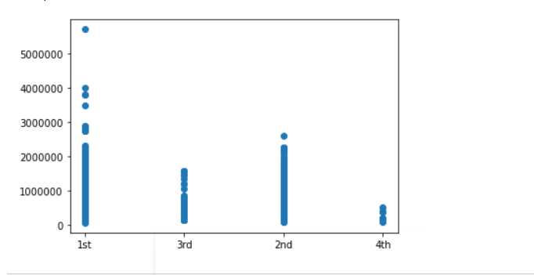
No of Owner vs price:-
Observation:-
We can observe that owner 1st vehicle is high price this is natural and we observe that increasing no of owners the price of the vehicle is decreasing we can see, so our observation is vehicle with 1st owner has high price

Slide 11
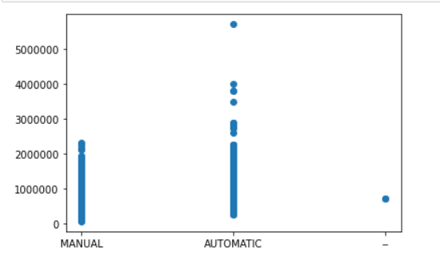
Transmission:-
There are two types of transmissions are there one is manual and another one is automatic we can see that vehicle with automatic transmission has high price compared to manual transmission vehicle
And there is another category ‘-‘ this is non usefull data we will remove it later

Slide 12
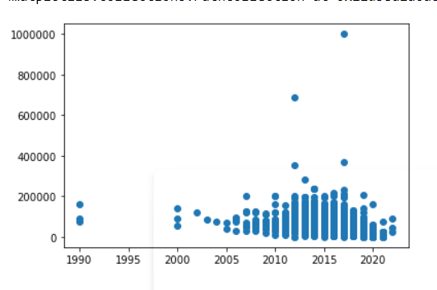
Year vs kilometers driven :-
Observation:-
We can see that most of the vehicles are between 2005 to 2020 almost all the vehicles are between range of 10km to 2.5 lakh km but we observe one thing is some of the data points are above 4lakh and 6lakh but the average life of car is 3.5 lakh km only so the data which is above 3lakh iam consider as outliers so I can remove those data points

Slide 13
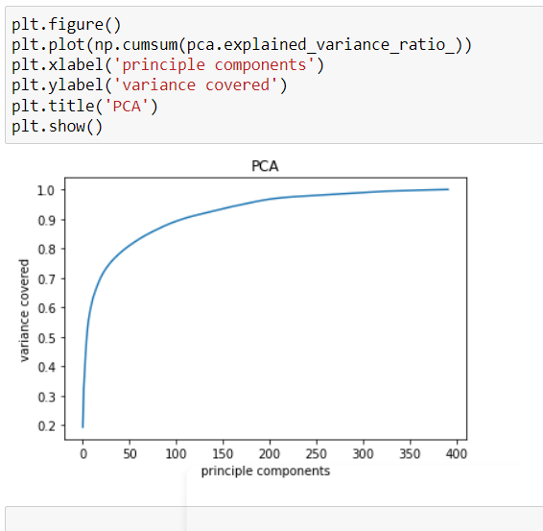
PCA (principle component analysis)
Conclusion:- Pca is used for reducing dimensions of the data set and it is also handle multicollinearity problem

Slide 14
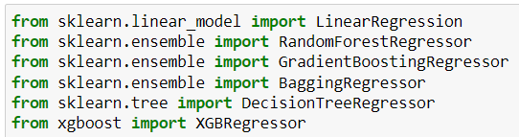
List of algorithms used for train and test score

Slide 15
Selecting the best model from two best score given models based on their scores
Algorithm trian score test score cross validation score 1)Randomforest 94.26% 63.25% 56.20% 2)Gradient boosting 78.004% 66.55% 57.19%
Conclusion :- to select the final model we have to check the error rate by using mae,mse,rmse

Slide 16
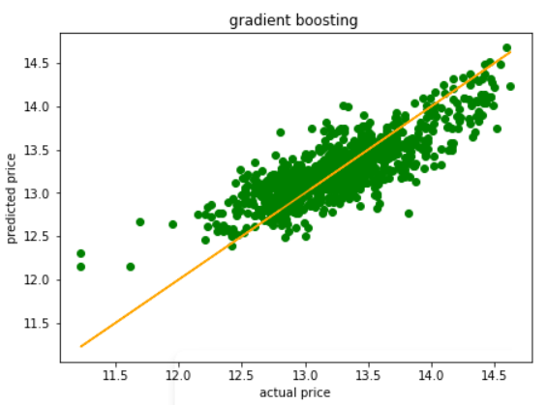
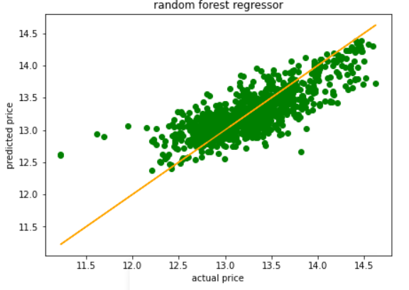
Choosing best model based error rate in two algorithms
Random forest
Mean square error = 0.083 Mean absolute error = 0.213 Root mean suared error = 0.288
Gradient boosting
Mean square error = 0.075 Mean absolute error = 0.214 Root mean suared error = 0.274
Conclusion :- the error rate is less in gradient boosting regressor model so I can choose this is the final model

Slide 17
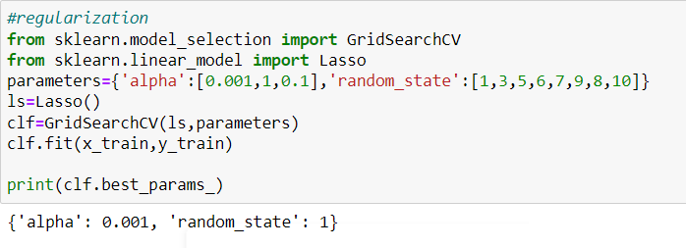
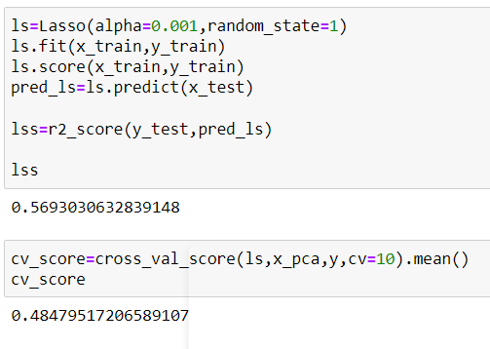
Regularisation of the model by using lasso
Conclusion:- By using lasso the score is not increased much

Slide 18
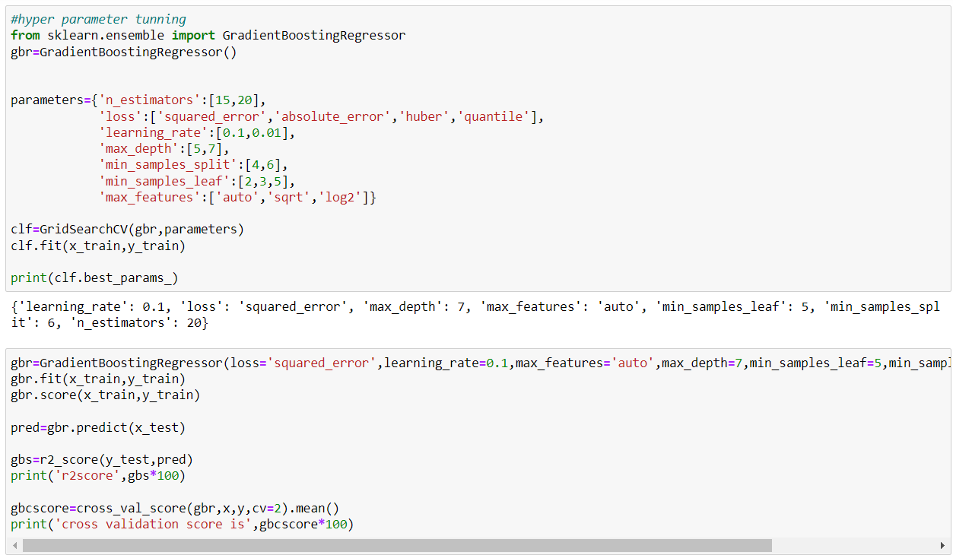

Hyper parameter tunning of the model
Scores after tunning
Conclusion:- score is not increased even applying hyperparameter tunning but there is a chance to increase changing parameters

Slide 19
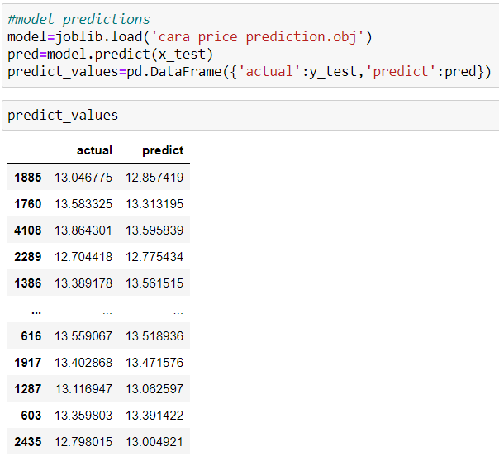
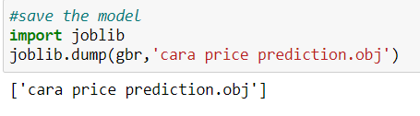
Saving the model by using joblib
Testing the model with test data
Conclusion:- Actual values are near to predicted values so our model works well

